Slide 1


AICTE CYCLE 2 (2025-26) -SMART/AUTOMATE IRRIGATION USING SOIL MOISTURE AND WEATHER DATA
NAME: SHAMSU NISHA N
AICTE Student ID: STU666d42658eb211718436453
AICTE Internship ID: INTERNSHIP_1748923002683e727a876ea

Slide 2

Learning Objectives
🔢 Apply Machine Learning for Binary Classification Problems Learn to train and deploy a machine learning model that classifies whether each sprinkler (parcel) should be turned ON or OFF based on real-time sensor data.
💻 Develop Scalable and Interactive Web Applications using Streamlit Build a responsive and user-friendly web interface using Streamlit to collect sensor inputs and display sprinkler status predictions.
📊 Preprocess and Normalize Sensor Input Data Understand the importance of feature scaling (normalizing values between 0 and 1) to ensure accurate and stable performance of machine learning models.
🌱 Understand the Role of AI in Precision Agriculture Gain insights into how artificial intelligence and machine learning can optimize irrigation systems to improve water efficiency and crop health.
GOAL

Slide 3
Tools and Technology used
CATEGORY | TOOL/TECHNOLOGY | PURPOSE
💻 Programming Language | Python | Core language for data processing, ML model, and app development
🧠 Machine Learning Library | scikit-learn | Used to train and save the ML model for sprinkler prediction
💾 Model Serialization | joblib | To load the pre-trained .pkl model for real-time inference
📈 Numerical Computing | NumPy | For data manipulation and reshaping input arrays
🌐 Web Framework | Streamlit | To build an interactive web UI for the user to input sensor values and get predictions
📊 Visualization (optional) | Matplotlib / Seaborn | Can be used during model training phase for plotting accuracy, etc.
🧪 Jupyter Notebook | Jupyter Lab / Notebook | For experimenting with data preprocessing and model training
🧠 Model Type | Binary Classifier (e.g., Random Forest, Logistic Regression) | Predicts ON/OFF status of sprinklers for each parcel based on input data

Slide 4
Methodology
1️⃣ Problem Identification
🌾 Traditional irrigation systems operate on fixed schedules, leading to water wastage.
🚱 Inefficient water use reduces crop yield and increases resource costs.
💡 AI is proposed to automate irrigation based on real-time sensor data.
2️⃣ Data Collection & Preprocessing
📊 Sensor data (moisture, temperature, humidity) collected from 20 farm parcels.
🧹 Data cleaned to remove noise and handle missing entries.
🔧 Features scaled between 0 and 1 using Min-Max normalization.
3️⃣ Model Training
🧠 Random Forest Classifier used for binary classification: ON (1) or OFF (0).
🗂️ Trained with 80% of data; 20% used for testing and validation.
📈 Evaluated using metrics like accuracy, precision, and recall.
4️⃣ Model Serialization💾 Trained model saved as a .pkl file using joblib.
🔄 Enables reuse of the model without needing to retrain.
⚡ Ensures faster and consistent predictions during app execution.

Slide 5
5️⃣ Web App Development
🌐 Developed interactive app using Streamlit for ease of use.
🧑‍💻 Users input live sensor data through the web interface.
💡 Model instantly predicts sprinkler status and displays results.
6️⃣ Prediction & Output
📥 The sensor inputs are first normalized to match the format used during training, ensuring accurate model performance.
✅ The machine learning model processes the scaled input and outputs a binary prediction: 1 = Sprinkler ON, 0 = Sprinkler OFF.
🖥️ The result is displayed clearly on the screen with user-friendly labels like "Irrigation Required" or "No Irrigation Needed".
7️⃣ Deployment & Testing
🧪 App tested with varied inputs to ensure stable performance.
⚙️ Performance and prediction accuracy verified in test cases.
📡 Ready for integration with real-time IoT-based sensor feeds.
✅ Final Outcome
🚀 Delivered an AI-powered irrigation system that saves water.
💧 Reduces human error and unnecessary irrigation cycles.

Slide 6
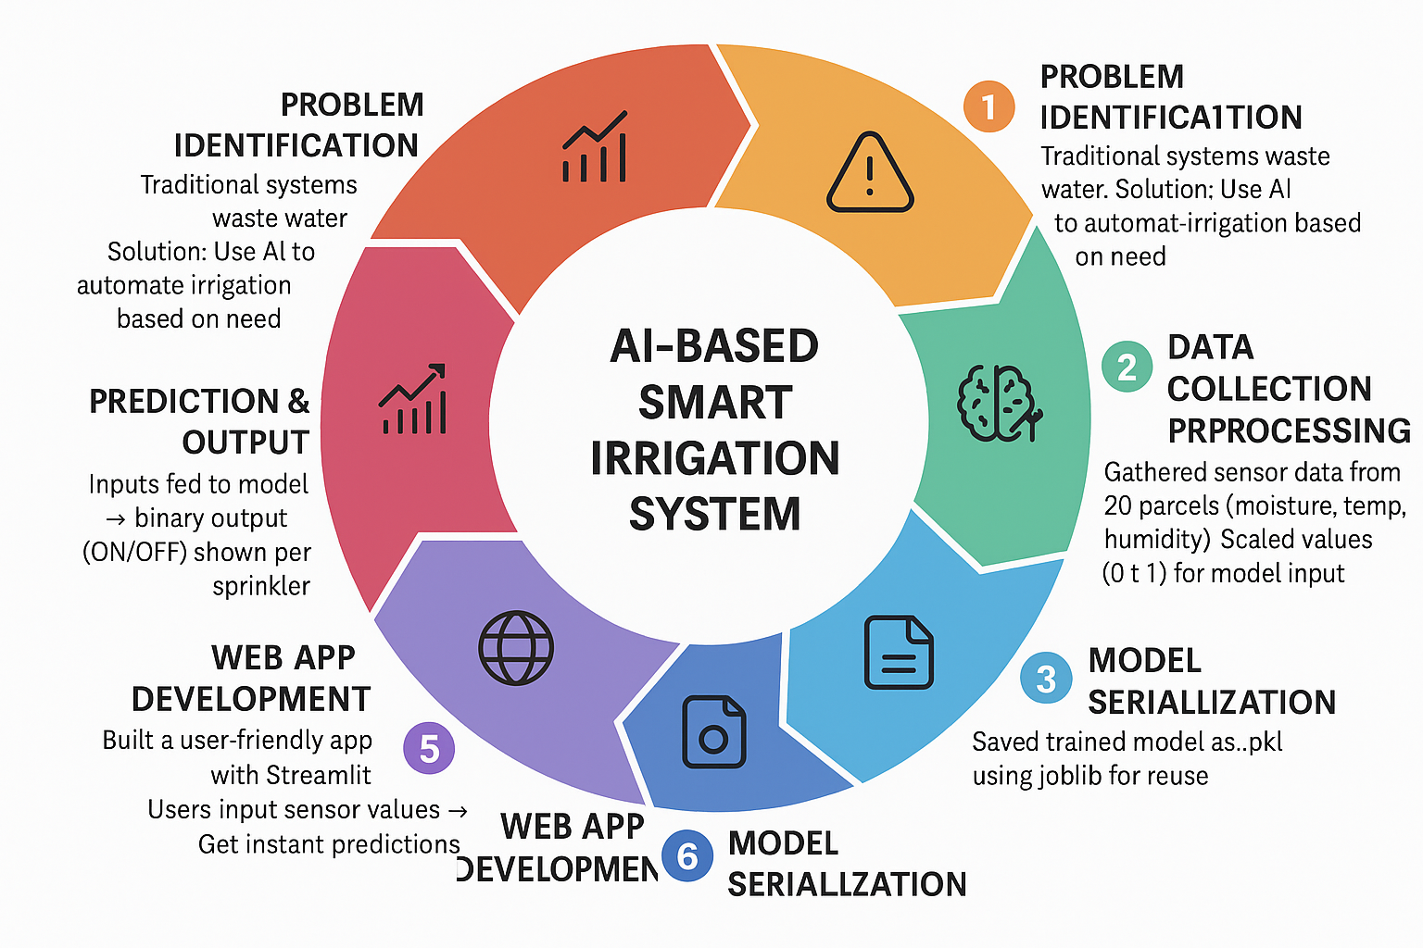

Slide 7
Problem Statement:
🚨 Problem Statement
🌿 Background Context
Agriculture is one of the most water-dependent sectors globally. However, the traditional irrigation practices used by farmers today are often inefficient. These systems are usually manually operated or time-based, lacking intelligent decision-making mechanisms.
❌ Key Challenges
Over-Irrigation and Under-Irrigation Farmers often overwater or underwater their fields due to guesswork or fixed schedules, leading to:
Crop diseases or stunted growth
Reduced yield and soil degradation
Water Resource Wastage With agriculture consuming more than 70% of global freshwater, inefficient irrigation contributes heavily to water scarcity, especially in drought-prone regions.
Lack of Automation Most existing systems are not sensor-driven or AI-powered, making it difficult to respond to dynamic field conditions like:
Varying soil moisture
Temperature fluctuations

Slide 8
Solution: GITHUB LINK: Shamsu0802/IBM-projects
🧠 1. Machine Learning for Irrigation Decision-Making
Train a binary classification model using historical sensor data.
Model predicts whether a sprinkler should be ON (1) or OFF (0) based on:
🌡️ Temperature
💧 Soil Moisture
💦 Humidity
🌤️ Light Intensity
...and other relevant features
🧪 2. Data Preprocessing and Normalization
Apply Min-Max scaling to normalize raw sensor values between 0 and 1.
Ensures model stability and better performance across sensor ranges.
🛠️ 3. Deployment Using Streamlit
Build an interactive, user-friendly web interface with Streamlit:
Users input real-time sensor values (scaled).
Model instantly displays whether the sprinkler should be ON or OFF.
Lightweight and easy to deploy on local or cloud environments.

Slide 9
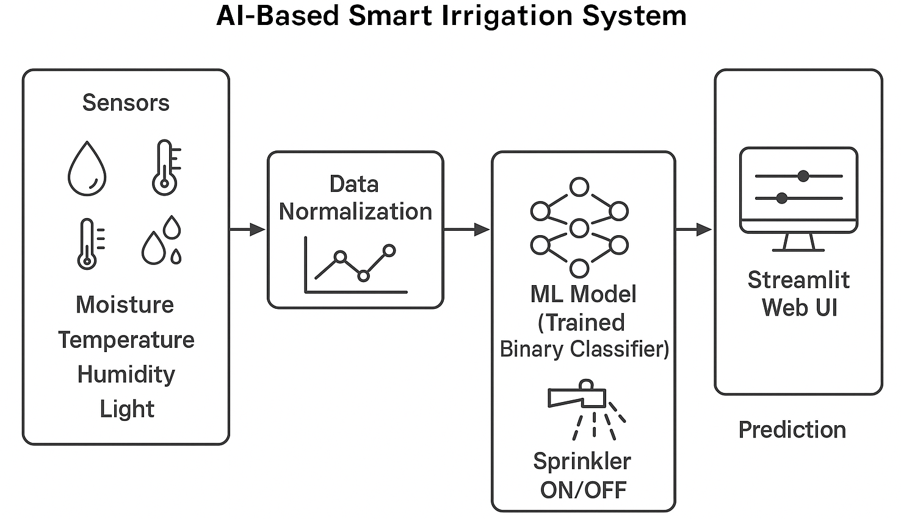
🌐 4. Real-Time Decision System
Integrate the model into an IoT-based architecture (future scope).
Enable automatic activation/deactivation of irrigation sprinklers based on predictions, without manual intervention.
🌱 5. Precision Agriculture at Scale
Helps farmers:
Reduce water waste 💧
Improve crop health 🌾
Maximize yield 🌽
Lower operational costs 💰

Slide 10
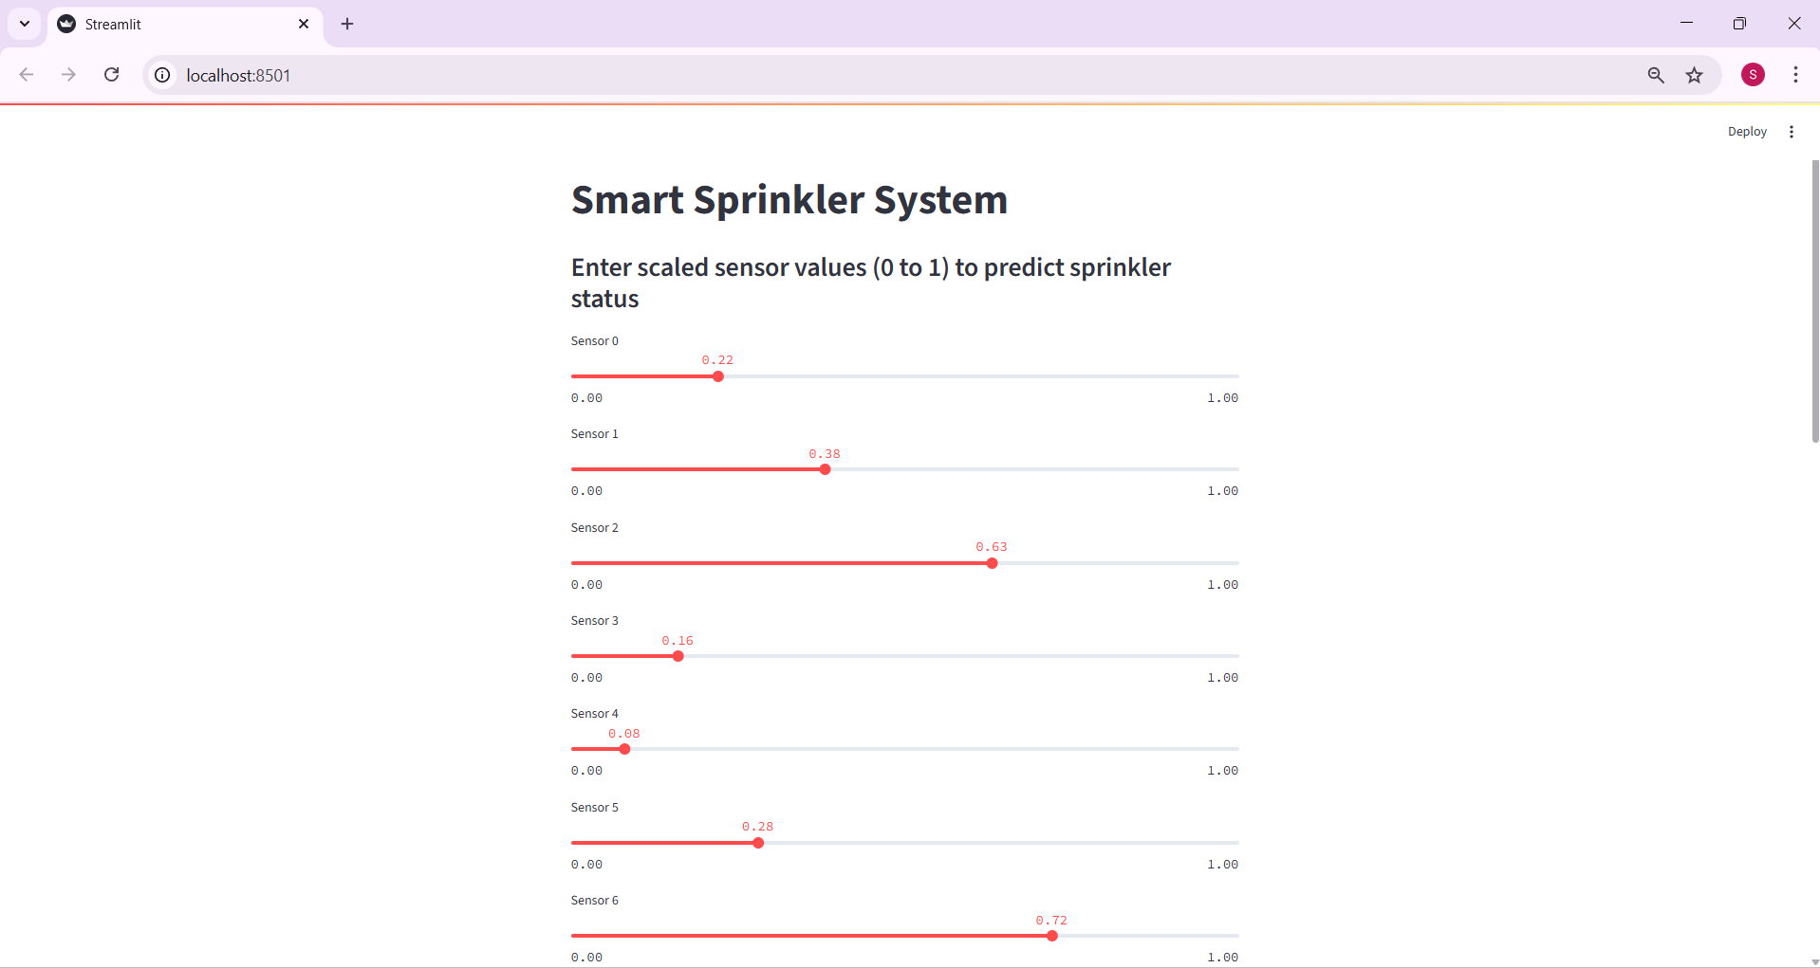
Screenshot of Output:

Slide 11
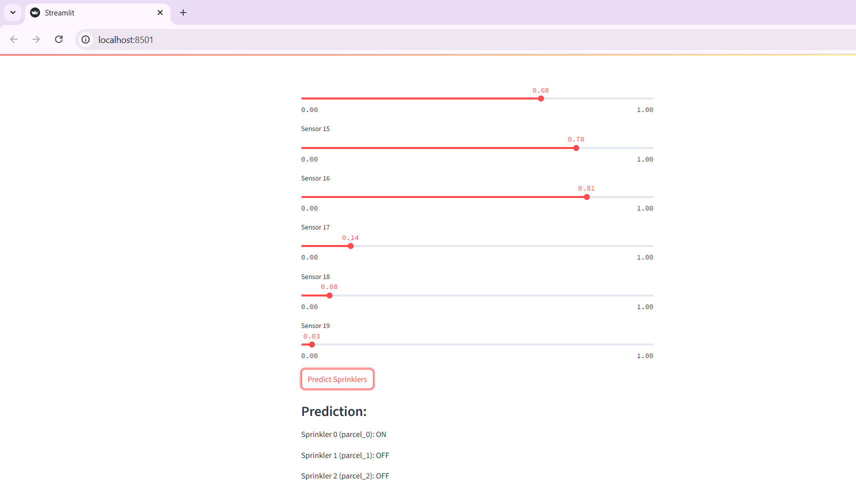
Screenshot of Output:

Slide 12
Conclusion:
🌾 The AI-Based Smart Irrigation System presents an intelligent, data-driven approach to agriculture by analyzing sensor inputs like temperature, humidity, and soil moisture to automate water distribution. This ensures that crops receive the right amount of water at the right time, minimizing wastage and boosting productivity. The system significantly contributes to resource conservation, especially in regions facing water scarcity.
🚀 With its ability to operate with minimal human input and adapt to real-time environmental conditions, this smart solution stands out as a key enabler of precision farming. It not only helps farmers make informed decisions but also enhances crop health, yield, and sustainability. As the world moves toward climate-resilient agriculture, solutions like these will be critical in securing global food production. 🌍💧🌱
📈 Looking ahead, the integration of machine learning and cloud-based analytics can further optimize this system, enabling predictive irrigation and remote monitoring. With continued innovation and awareness, this model can be scaled across various agricultural landscapes, empowering farmers with smart, efficient, and eco-friendly practices. 🧠📡👨‍🌾

